Slide 1
Rules for the 2025 Race
William Shih, Deputy Race Director

Slide 2
EVENT UPDATES
The Rules are periodically clarified or amended to meet the needs of the specific race.
Rule 29 requires solar car teams to make periodic reviews of these updates to stay up-to-date.
  Rules updated per Event Update 2025-1

Slide 3
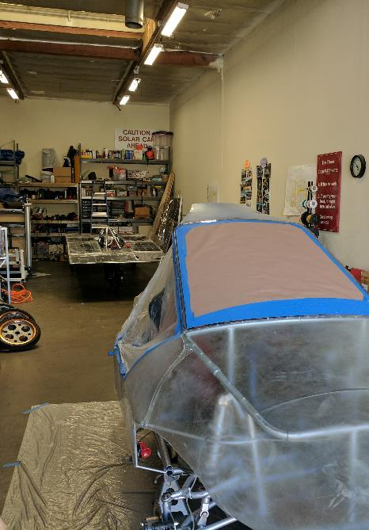
Rules Overview
Do:
  Keep copies of rules throughout workshop
  Following engineering lifecycle: requirements, design, implementation, verification
Don’t:
  Just read once or all in one sitting
  Look at another car’s design and assume it complies with rules (grandfather; waivers)
Changes from 2024 rules noted in Blue

Slide 4
Categories of Rules Changes
Event Updates from 2023-2024 Race Year
Mechanical Subsystem
Electrical Subsystem
Electric-Solar Power Division
Cruiser Division
Cross-Country Races
Administrative

Slide 5
Event Updates from
2023-2024 Race Year
Rule 3.8 – Prohibit use of another solar car’s frame
Rule 5.4.2(d) – Remove distance for main battery pack fuse
Rule 5.4.5(a) – Allow push-rotate disconnects
Rule 5.13(k) – Battery spill kits only required for lead-acid batteries
Rule 32.2.6(a) – Allow LiFePO4 for Electric-Solar

Slide 6
Mechanical Subsystem
Rule 5.2.2 – Roll bar should have no kinks/buckles
Rule 5.13(a) – Safety belts must be unexpired
Rule 5.13(j) – Racing style adjustable seats allowed if installed per manufacturer’s specifications
Rule 5.13(l) – No tinted windows allowed

Slide 7
Electrical Subsystem
Rule 5.4 – Calculate Lithium-battery capacity per nominal voltage (instead of minimum or typical)
Rule 5.4.1.3 – Clarify requirements for BMS to include over-temperature
Rule 5.4.3(d) – Battery boxes cannot be in path of egress
Rule 5.4.3(e) – Clarify that forced-air ventilation is required for flooded PbAcid batteries. Allow forced-air ventilation for Li-chemistry batteries
Rule 5.12.1 – Stop lights must be independent of turn indicators and hazard lights
Rule 10.1.x – Increased solar array efficiency from 22% to 23% for Classic, Advanced Classic, and Electric-Solar

Slide 8
Electric-Solar Powered Division
Rule 32.2.2 – Minimum dimensions removed; vehicles must fit within maximum dimensions and require side-by-side seating
Rule 32.2.3 – Ballast must be secured within the vehicle
Rule 32.2.5 – Increase battery capacity from 2.625 to 5.25 kWh per battery pack
Rule 32.2.6 – Clarify disconnect switches and relay/contactors required
Rule 33.2.7 – Require a container for trunk space
Rule 32.3.1 – Change charging station limit from size to power, allowing teams to create their charging station in any way they desire, so long as it is <= 2.5 kW.

Slide 9
Cruiser Division
Rule 33.2.4 – Ballast must be secured within the vehicle
Rule 33.2.5 – Need two roll bars, one for each row of passengers
Rule 33.2.8 – Require a container for trunk space
Rule 33.5.1 – Clarify non-moving penalties have multiplier of 4 for points
Rule 33.6 – Require Cruiser to have daily tasks like Electric-Solar

Slide 10
Cross-Country/Track Races
Rule 6 – Clarify how ties are broken for track races (highest average speed per lap)
Rule 6.1 – Elapsed time includes required trailering time; allows teams to choose when to charge their vehicle throughout the day
Rule 6.7 – Minimum speed of 20 mph also applies to track race
Rule 20.x – Clarify passing/overtaking rules. Team being passed does not need to slow down. Additional provisions in Rules Updates or Policies and Procedures.

Slide 11
Administrative
Various clean-up and consolidated rules
Rule 3.6
  Clarify need for data sheets on relay/contactors and brake pedals
  Clarify team photos are due March 1st, with updates to June 1st
Rule 3.6.1 – Penalty for incomplete registration
Rule 5.4.3(d) – Battery boxes must be protected by crush zones
Rule 8.3 – Clarify fees and what is covered. Increases participants from a total of 14 to a total of 15.
Rule 8.9 – Health testing required for cross-country races

Slide 12
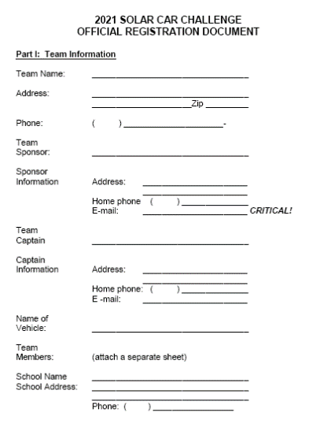
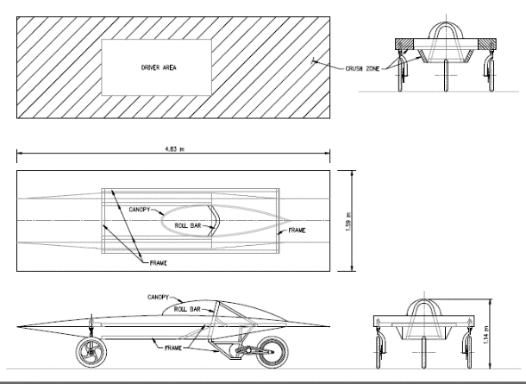
Registration
Sections 1 – 3: Purpose, Administration, Entries and Registrations
Registration Documents and Registration Fee requirement March 1st:
(1) Detailed CAD drawings showing mechanical structure, including “crush zones.” Crush zones must be clearly labeled. Location of major components and notional driver must be shown.
(2) Detailed schematic / wiring diagram showing electrical system.
(3) Digital team photo [emailed]
(4) Manufacturer’s data sheets for batteries showing type & capacity
(5) Manufacturer’s data sheets for solar array, including list price
(6) Manufacturer’s data sheets for motor and motor controller
(7) Manufacturer’s data sheets for array and battery cutoff switches
(8) Manufacturer’s data sheets for main fuses
(9) Manufacturer’s data sheets for wheels and brakes
(10) Manufacturer’s data sheets for suspension and steering
Digital and hard copies required by March 1st.

Slide 13
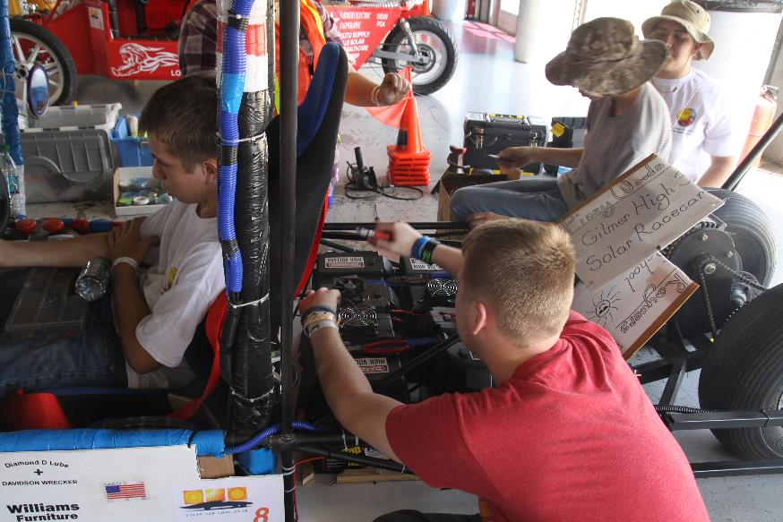
Rule 3.8 – Design of Solar Car
It is the intent of the event that the solar cars be designed and constructed by high school students on the solar car team.
No portion of another vehicle’s frame may be reused in a solar car unless the team re-engineers/ modifies the frame to fit the team’s solar car design or to install separate off-the-shelf components.

Slide 14
Rule 3.9 - Scrapbook
Scrapbook must be shown to Check-In to Race.
Scrapbook must show history of the team building the solar car, including team engineering decision-making.
Scrapbook will show team photos, design & planning, CAD drawings, fundraising, testing.
Digital copy of scrapbook due June 1st.

Slide 15
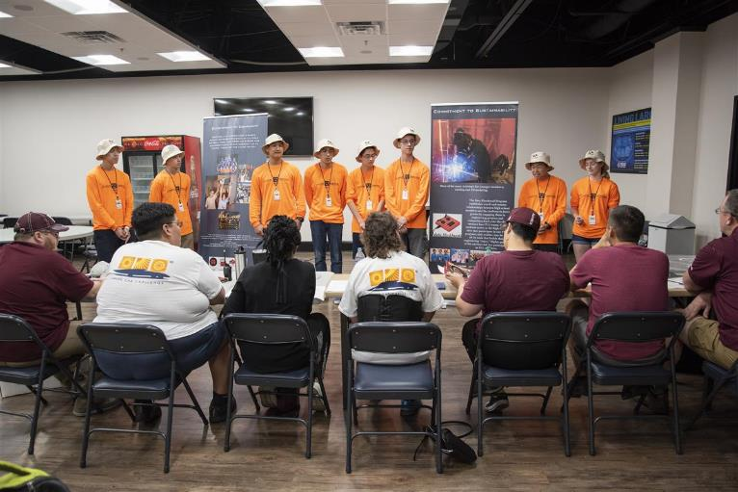
Rule 3.10 – Oral Presentations
Up to 20 laps not available for oral presentations.
Presentation show discuss the teams overall planning, including engineering decisions.
Teams have a strict 8 minutes to give their presentation.
Judges will now give feedback per Oral Presentation Guidelines

Slide 16
Rule 3.5 – Qualifier
Qualifier for the 2021 Race will include:
  3-Day Scrutineering
  Stage One – First Day of Racing
The top teams in each Solar Car Challenge Racing Division will move on to the three-day Stage Two of racing. [Approximately 25 teams]
  The winner in each division will be the team that accumulates the most laps in Stage 1 and 2.
  All teams will receive an Official Race Ranking

Slide 17
Section 10: DIVISIONS
Classic Division: No hub motors; lead-acid or LiFePO4 batteries; solar modules or cells at ≤ 23% efficient
Advanced Classic Division: Classic Division cars with 3 or more years experience in Solar Car Challenge
Advanced Division: Hub motors; prefabricated solar car molds; advanced battery chemistries
Electric-Solar Powered Car Division: Solar cells on charging station; Classic Division technology; 2 x 5.25 kWh battery packs
Cruiser Division: Seating for four; totally enclosed; solar array integrated into the skin of the vehicle; workable trunk

Slide 18
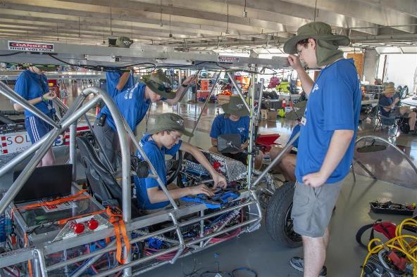
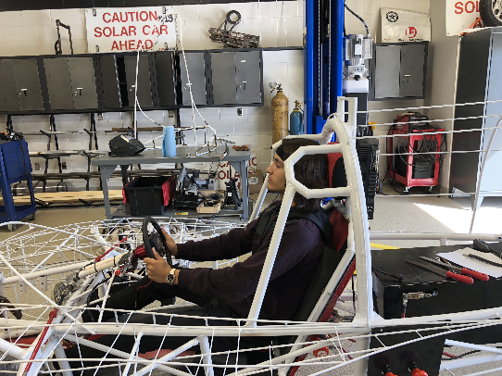
Rule 5.2.x –
Safety Cell, Crush Zone, Roll Bar
Safety Cell– rigid protection encompassing entire driver; minimum OD of 1.9cm; minimum 5cm clearance to driver
Crush Zone – structural components designed to collapse on impact; minimum 15cm clearance to driver; minimum coverage
Roll Bar – protects driver in event of rollover; continuous piece of metal; minimum 5cm vertical clearance; minimum OD of 5cm; minimum wall thickness based on material; welded to frame

Slide 19
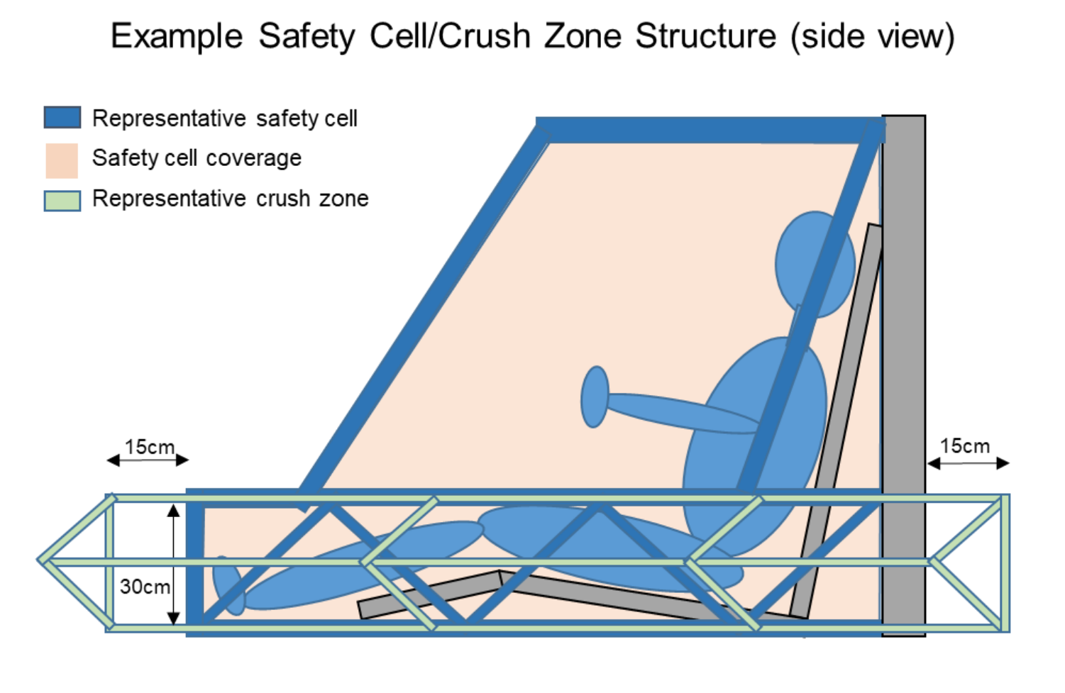
Safety Cell / Crush Zone Details
Both Safety Cell and Crush Zone must encompass the entire driver
Crush zone are structural components designed to collapse on impact
Safety Cell structure protects driver in event of collision; should not deform
Requires padding to protect driver
Crush zones must protect both driver AND battery pack

Slide 20
Section 5.4/5.7 – Electrical
Rule 5.4 (Battery): 5.25 kWh max at 20 hr discharge rate; terminals must have locking washers (see 5.7.3 below).
  For Lithium-based chemistries, use nominal (1C) capacity
Rule 5.4.2 (Main Fuse): 125% of expected peak current, separate enclosure; rated as appropriate for DC voltage
Rule 5.4.3 (Enclosures): Rigid, must have forced-air ventilation; no venting into driver’s compartment; cannot be located at front of vehicle
  No forced air ventilation required for LiFePO4 (teams may still implement)
  Battery boxes cannot be located in front of driver
Rule 5.7.1 (Wire): No HV wiring in driver’s compartment
Rule 5.7.3 (Connections): Connections conducting > 36V must be secured by locking washer

Slide 21
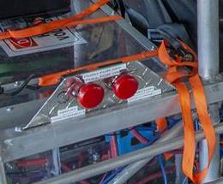
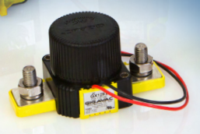
Rule 5.4.5 – Disconnect Switches
Two sets of two switches required
  Motor Disconnect / Array Disconnect
  Internal (“Driver”), External
Relay/contactor must interrupt full load current at system voltage
Switch operates control signal of relay/contactor
  Can be either “push-pull” or “push-rotate”
No high voltage wiring in driver compartment!

Slide 22
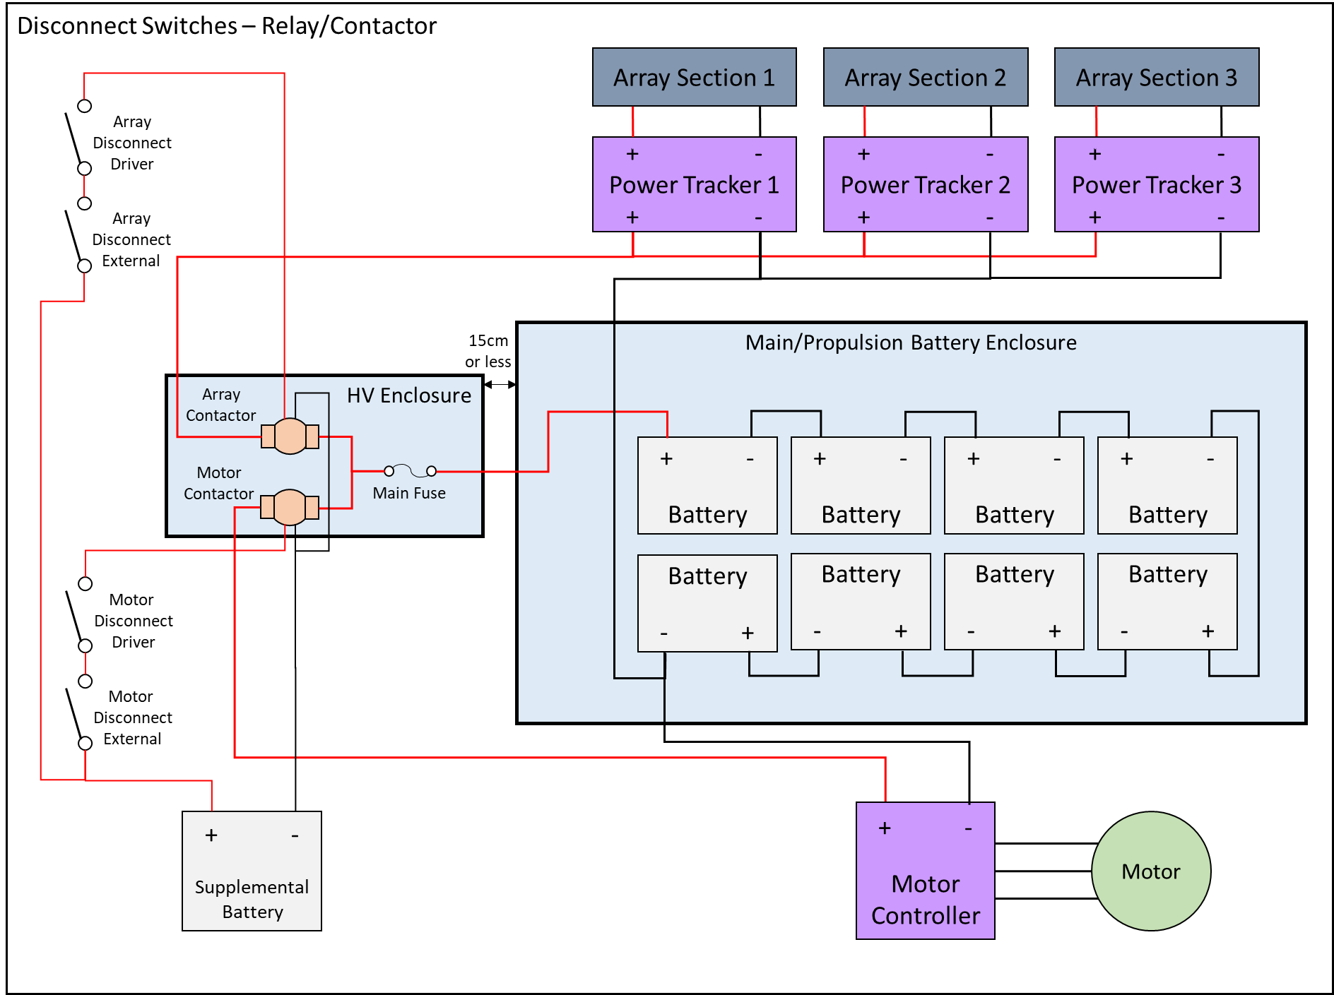
Relay/Contactor Circuit
Control Switches
Relay/ contactor

Slide 23
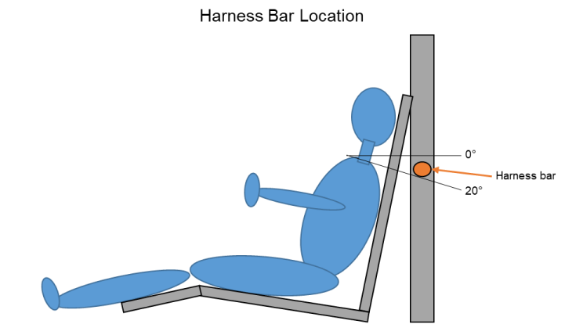

Rule 5.13 – Driver Safety
(a) Safety Belt must be 5 point lap/shoulder harness; attached to structural member per manufacturer’s instructions.
  Requires mounting shoulder belts vertically lower than driver’s shoulder
(b) Cars with body shells must have shells attached to each other
(d) Windshield must protect entire head
(e) Cars equipped with appropriate fire extinguisher for battery chemistry
(j) Seat back braces required for seats on adjustable rails
Seat back brace

Slide 24
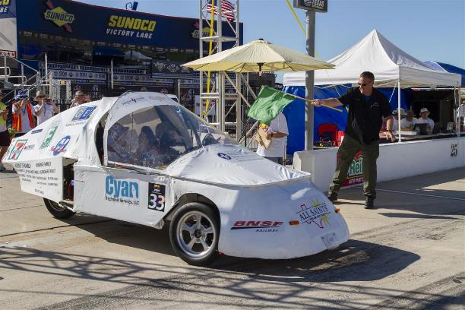
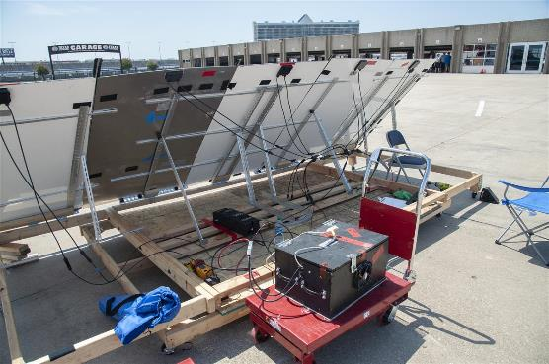
Section 32 – Electric-Solar Powered Car
Simulates a “real world” solar application
  Two passenger vehicle
  Charging Station simulates permanent facility used to charge vehicle
Same rules as Classic Division, with exceptions
Rule 32.2.3a (Configuration): Passengers must be seated side-by-side
Rule 32.2.6 (Battery): Two battery boxes, each with maximum 2kWh capacity; safe battery exchange procedure
Rule 32.2.7 (Disconnects): Solar Car must have two Motor Disconnects; Charging Station must have single Array Disconnect
Rule 32.2.8 (Trunk): Externally accessible storage required
Must provide team member to monitor Charging Station during race hours
Rule 32.7 (Team Assignments): Accomplish one special task each day to demonstrate real-world function

Slide 25
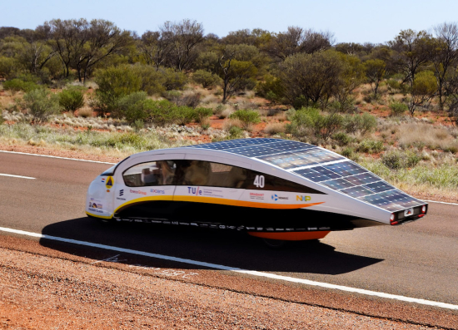
Section 33 – Cruiser Division
Resemble regular passenger vehicle; provides opportunity to strategize based on number of passengers
  Points = # of passengers x distance traveled
Same rules as Advanced Division, with exceptions
  Must have four wheels
  Must accommodate four passengers; each with immediate access to door for entry/exit (implies 2x2 configuration)
  Rule 33.3 – Allows for 10.5 kWh battery capacity
  Rule 33.3.5 – Body must be completely enclosed
  Rule 33.3.6 – Solar array must be integrated into car body
  Rule 33.3.7 – Must have externally accessible storage space

Slide 26
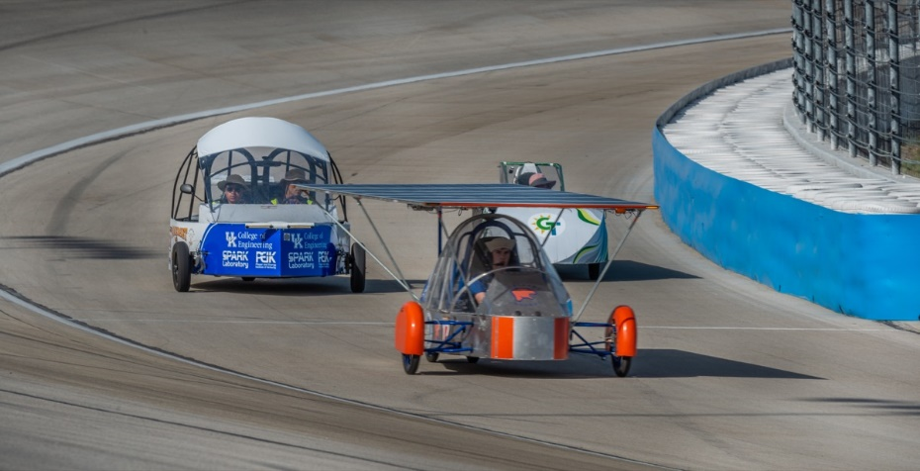
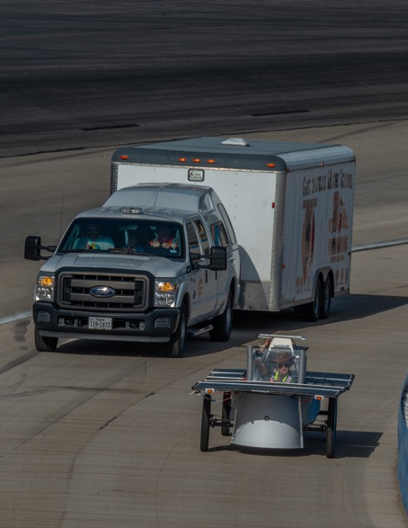
Policies and Procedures for
Closed-Track Races
Addendum to be provided to participants
Drive as close to inside wall, unless passing
Cars must complete pass in reasonable time
Radio Checks/Driver Change Area
Caution Zones
Dedicated Electric-Solar Powered Battery Exchange Area
Spotters

Slide 27
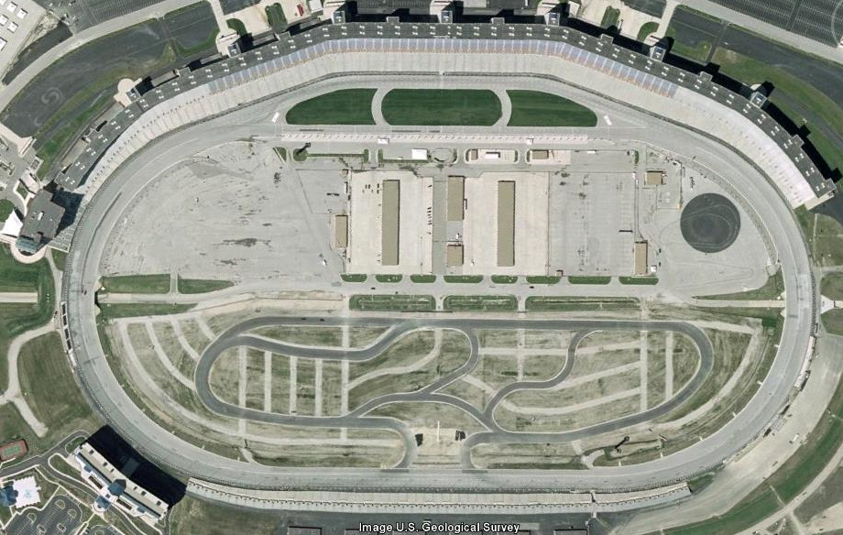
Cut into black triangle unless passing going into Turn 1.
Middle
End
Front Straight
Begin
Begin
End
Vehicles entering Turn 1 from pit lane yields to main traffic.
Turn 1
Stay to inside coming out of Turn 4, stay to right of cones to stay on track
Turn 4
End
No 3 wide passing after first cone. Can use black triangle if desired.
Begin
At end of cones, can resume 3 wide passing
Begin
Must complete 3 wide passing by first cone.
End
Turn 2
Slower cars should drive in apron on back straight
Turn 3
End
Begin
Back Straight
Begin
Middle
End

Slide 28
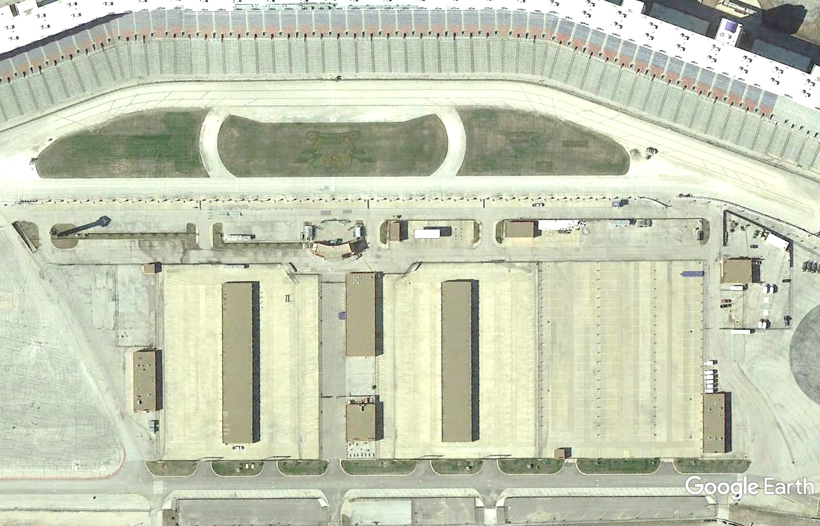


SPOTTERS
PIT LANE
ALT TRACK EXIT
TRACK EXIT
PIT SLOTS
TRACK ENTRY
SUPPORT IN/OUT
OTHER TEAM VEHICLE
PARKING
TMS USE
ONLY
CHARGING STATIONS
MEDIA
CTR
TRAILER PARKING
PRIMARY GARAGE
SUPPORT PARKING
SUPPORT PARKING
TRAILER PARKING
SECONDARY GARAGE
TMS USE
TRANSFER BETWEEN GARAGES

